Slide 1


Sales & Finance
Report

Slide 2
Content
Introduction
Problem Statement
Data Source & Tools
Data Model & DAX Measures
Insights on sales & Finance Reports

Slide 3
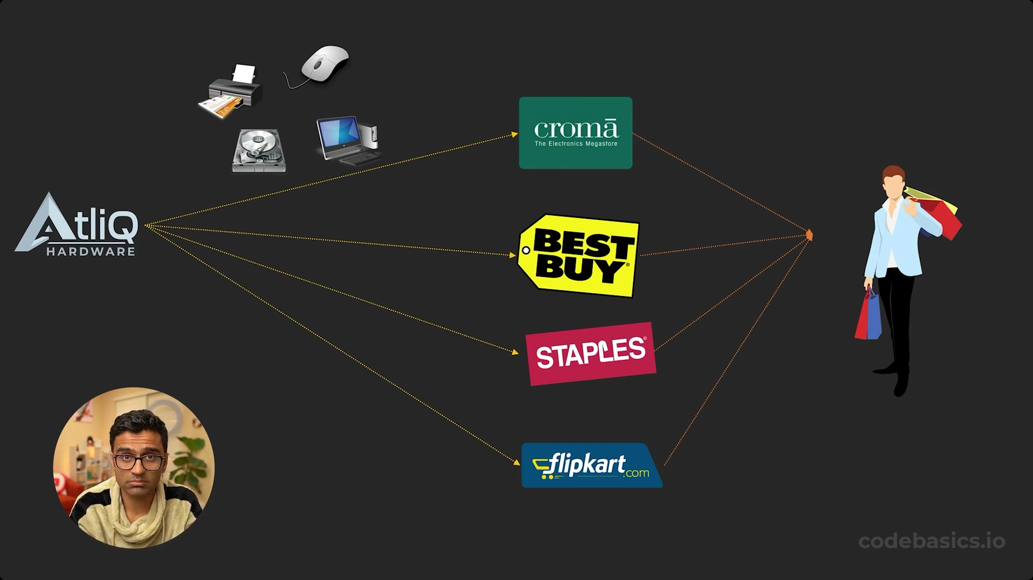
Introduction
AtliQ Hardware is a leading company
that supplies computer hardware and
peripherals to the clients across the world.

Slide 4
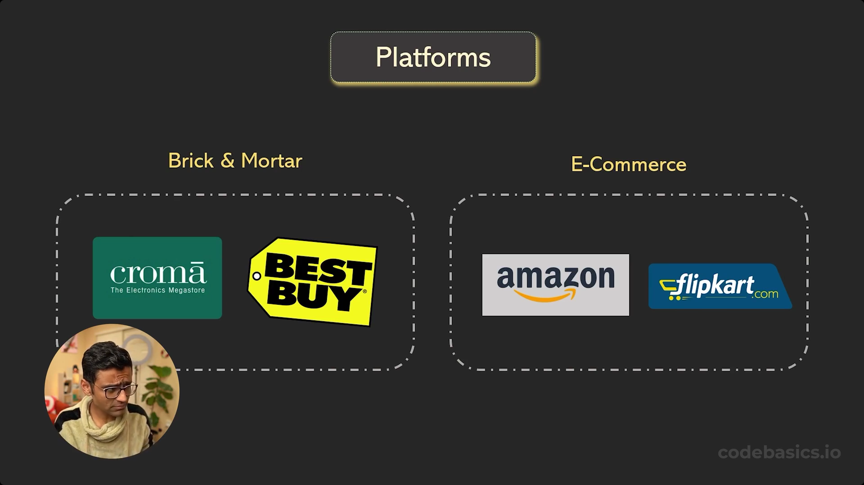
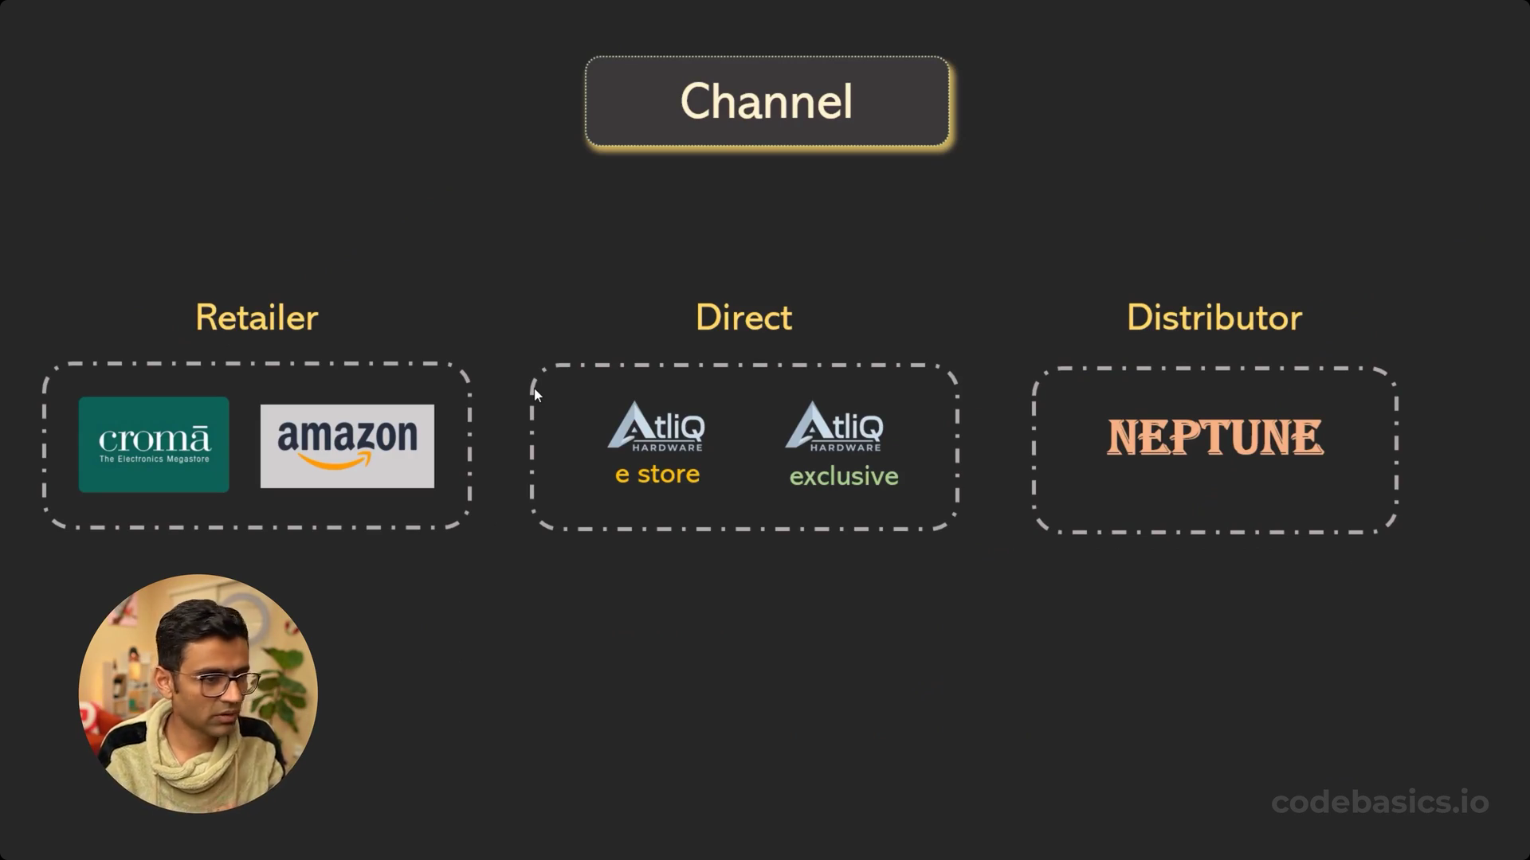
Platforms & Channels

Slide 5
Problem | Statement
AtliQ Hardware is facing Significant losses in recent years.
Rely on hand written reports
Need of insights for informed Decision-making.
Request for a Data Analyst to create a Excel report.
Analysis focused on Sales and Finance Performance

Slide 6
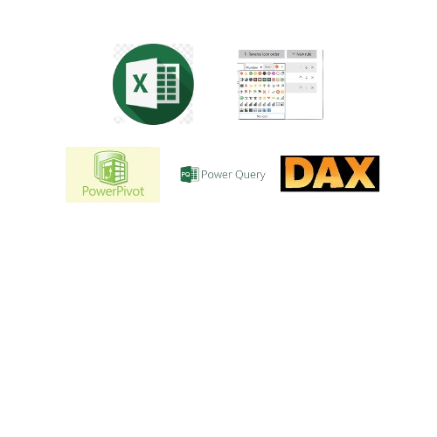


Data | Sources & Tools
Excel
Power Query
Power Pivot
Pivot Table
Dax measures and Columns
Conditional Formatting

Slide 7
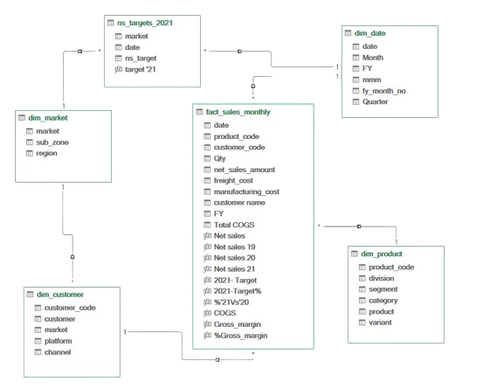
Data | Modelling

Slide 8
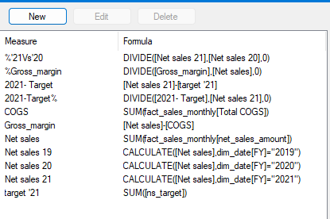
DAX- Measures

Slide 9
REPORTS
Sales
Finance
Customer Performance Report
Top 10 Products
Division Level
Top & Bottom 5 Products
New Products – 2021
Top 5 Countries
P & L Yearly
P & L Monthly
P & L Market
GM% Quarterly

Slide 10

Sales Report

Slide 11
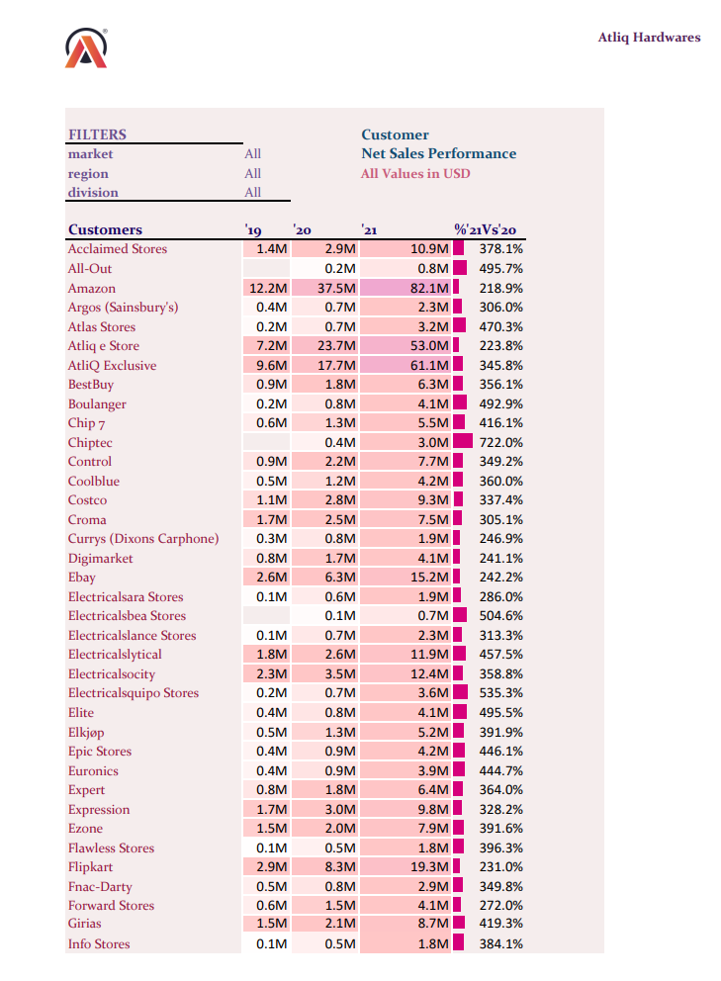
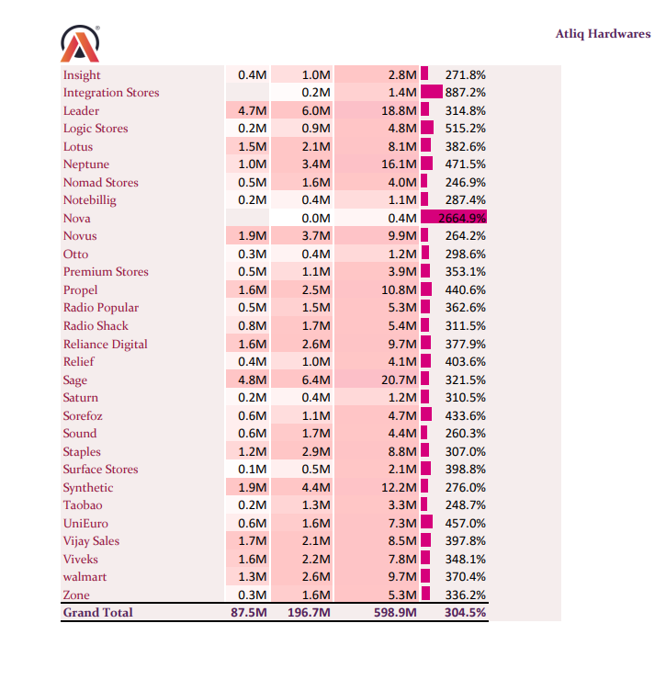
Customer Net sales Performance

Slide 12
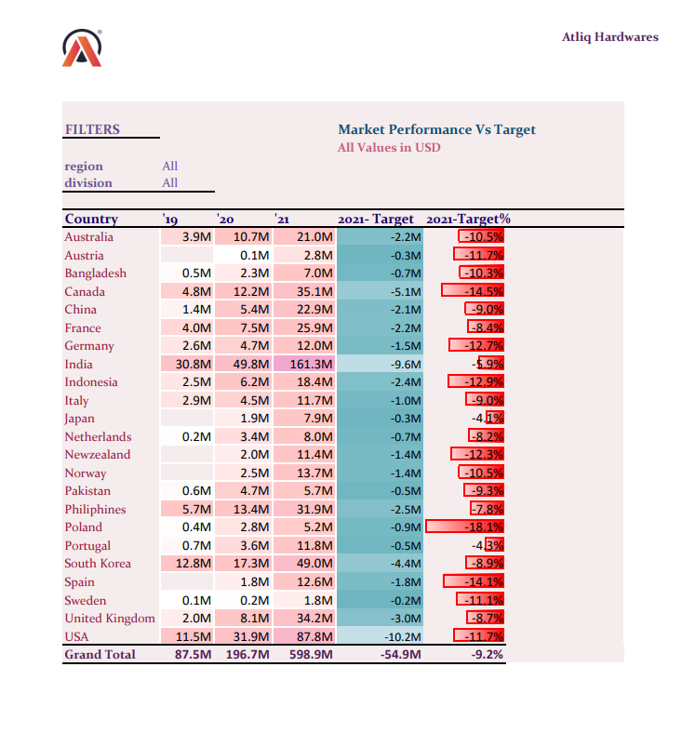
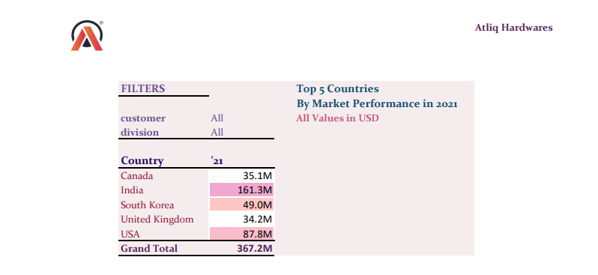
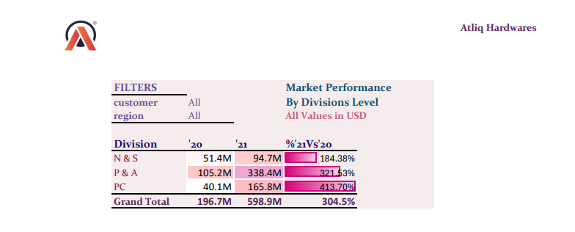
Top 5 Countries By Market Performance
Market Performance Vs Target
Market Performance By Division Level

Slide 13
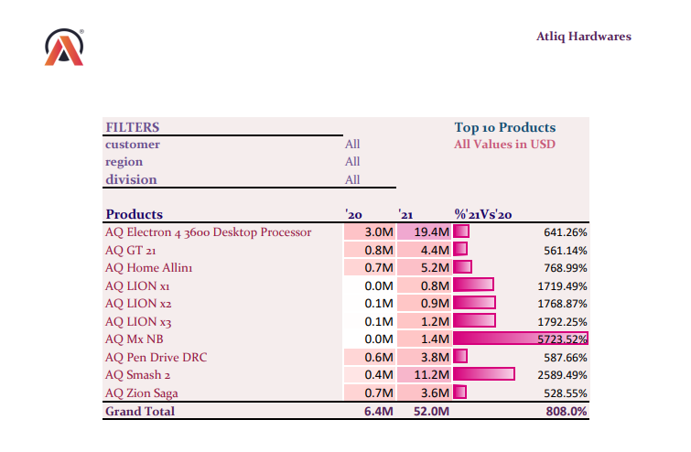
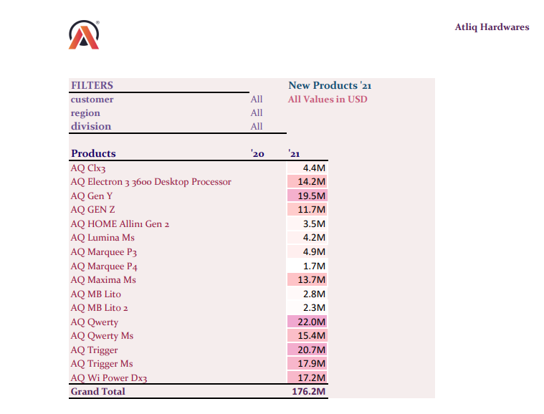
Top 10 Products || New Products ‘21

Slide 14
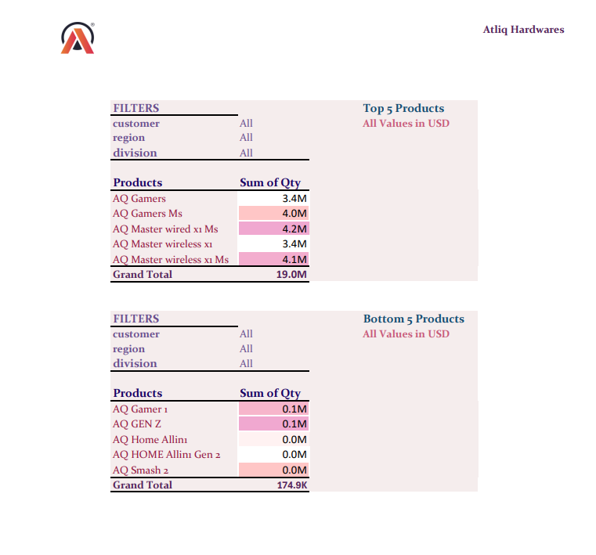
Bottom 5 Products || Top 5 Products

Slide 15
Finance Report

Slide 16
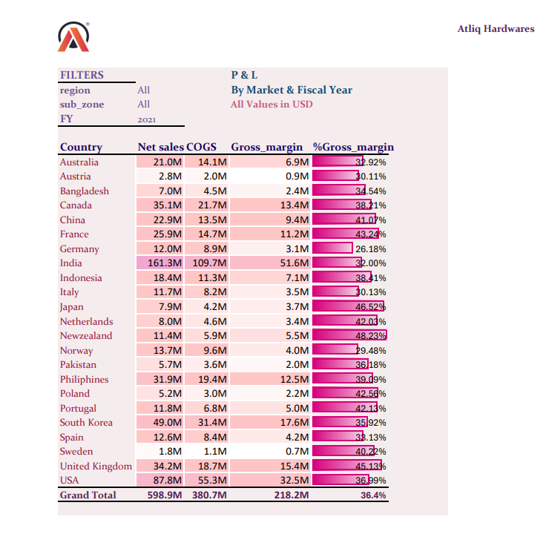
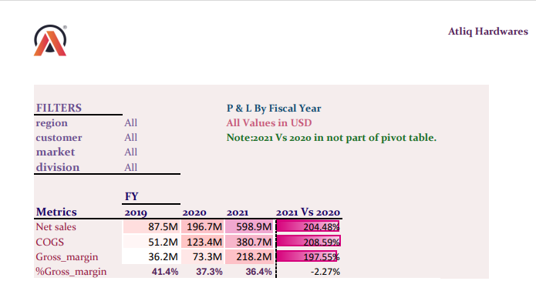
P & L By Market & Fiscal Years

Slide 17
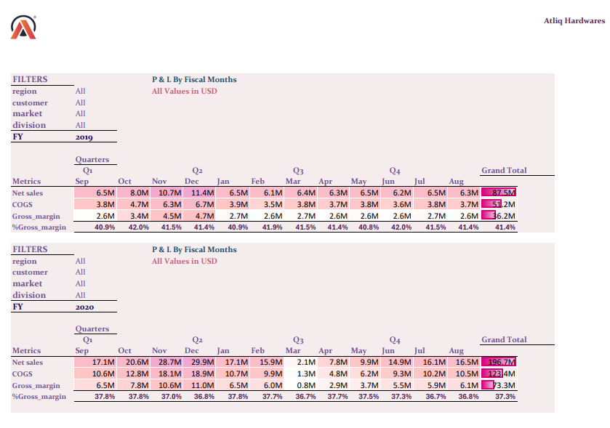
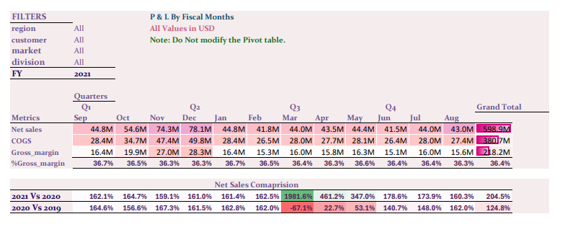
P & L Monthly Report

Slide 18
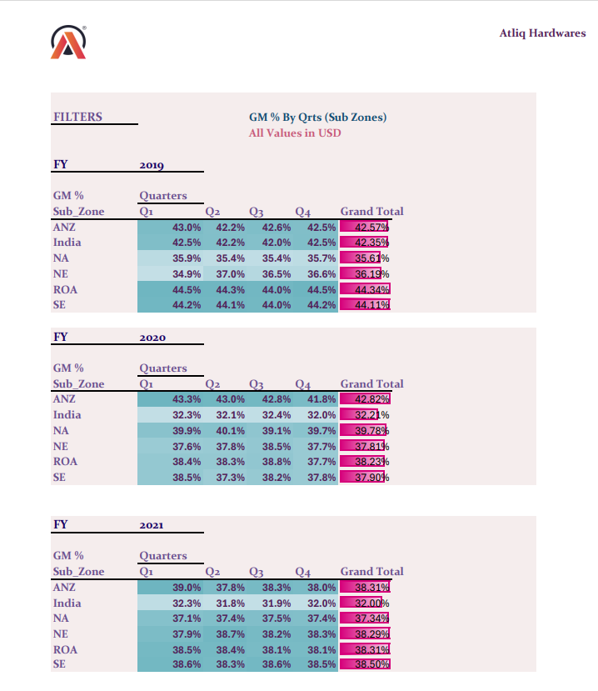
GM % By Quarters (Sub-Zones)

Slide 19
Thank |You| For| Your| Time & Patience

